Slide 1
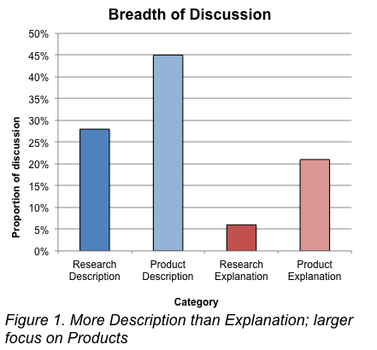
Twitter as a tool for public engagement with emergent technologies?
Project Overview
Twitter and other social media offer the potential to engage science enthusiasts and connect interested publics. In this study, our two main research questions ask: Is Twitter being used as a tool of interactive engagement between the public and nanotechnology experts? And what proportion of tweets about nanoscience are attempting to explain nanotechnology or engage interested publics?
We look at discussion of nanotechnology and found that, In recent years, there has been an increase in Tweets that describe nanoscience and nanoproducts. However, there is less content that attempts to explain nanoscience in language suited to general audience. Tweets that do attempt to explain nanoscience, tend to focus on nano-based products. We also found a significant Grangers’ causality interaction between volume of Research Description Tweets and Research Explanation Tweets, meaning that at times, increase in Description Tweets leads to an increase in Explanation Tweets, while at other times, the opposite occurs.
Appelbaum, R., Harthorn, B. H., Hasell, A., & Stocking, G. Twitter as a tool for public engagement with emergent technologies? Presented at Democratizing Technologies: Assessing the Roles of NGOs in shaping technological futures Nov 13-15, 2014.
Figure 1. More Description than Explanation; larger focus on Products
Figure 3-4. Timeline by Subject type

