Slide 1
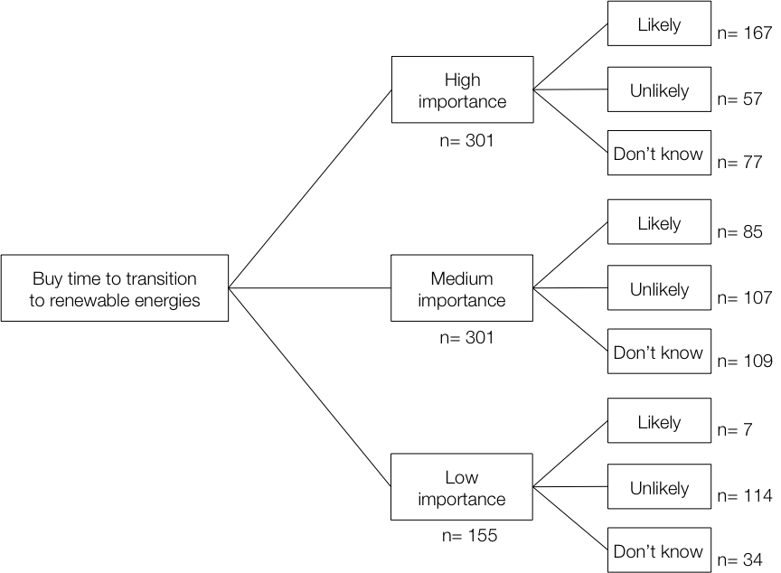
Using decision pathway surveys to inform climate engineering policy choices
Over coming decades citizens living in North American and European countries will be asked about a variety of new technological and behavioral initiatives intended to mitigate the worst impacts of climate change. A common approach to understanding public responses has been to conduct surveys; however, concerns that conventional survey methods are not up to the task prevail. Decision pathway surveys, we argue, can help better inform both respondents and policy makers by capturing many of the benefits of small-group deliberative conversations while meeting the needs of both publics and governments for large-sample stakeholder engagement
Methods (n=800)
6-step decision-making approach based on
PrOACT framework
Pathway structure groups into 4 main types of
questions: value positions, geoengineering design, policy tradeoffs, and tutorials
Results
Of three CO2 removal technologies, over 80% of participants favored planting new forests or adding biotic infrastructure (algae/plankton) to sequester carbon. The third option was storing carbon in industrial machines.
Of four sunlight reflection technologies, respondents favored technologies that increase reflectivity of buildings or road surfaces followed by using large mirrors to reflect light and heat away from the earth. The other two options were brightening clouds and injecting reflective particles into the atmosphere.
Those most concerned about climate change generally favor implementing climate engineering policies and investment in renewable resources (55-65%). This support is offered even though these participants regard the risks of climate engineering as more likely than its benefits.
Figure: One branch of decision pathway survey
Gregory, R., Satterfield, T., & Hasell, A. (2016). Using decision pathway surveys to inform climate engineering policy choices. Proceedings of the National Academy of Science, 2016 113 (3) 560-565; doi:10.1073/pnas.1508896113

