Slide 1
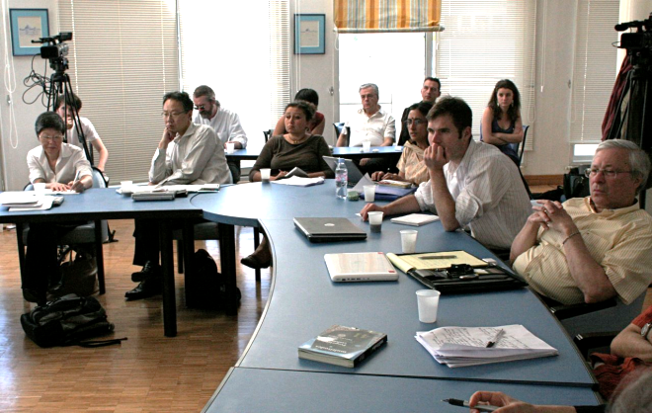
NSF SES 0938099
International Technology Innovation Workshop
Aims
The workshop was convened to ask:
● Where does the innovation model currently stand?
● Are variants in Europe and Asia more successful?
● Can a better model be produced?
Global experts in innovation from 4 continents convened in Lyon, France in April 2010 to examine recent innovation research and practice.
Two interim versions of a proposed non-linear model.
● partially replace non-social steps with fully social counterparts.
● better acknowledgement and coordination of all social actors implicated in the innovation process
Concerns:
Environment
Health
Safety
Society
Expression
of
widespread social need
Elections
Hearings
Representation
Continuous
dialogue-based improvement
Innovation Players
Rights to
practice
Social narratives about goals of use, success
Targeted “moonshots” – 10x / 100x
Government:
Policies/Agencies
Patents vs
OpenSource
Government partnerships
Public / expert cogeneration of research
Likes/Dislikes
Concerns
Invention:
Synthesis
Implementation
Cost
Production
Users/Buyers
Acceptable costs
Business:
Mfg
Sales
Marketing
NGOs:
Distribution
Adoption
Continuous user inputs
Open source research communities
Investment:
Government
VC/Angels
Corporations
Industry
and community development
Negotiated hybrids
of proprietary & open
Invention disclosure
Money
Taxes
Shareholders/
Membership
Newfield, Christopher & Daryl Boudreaux, eds. Can America Still Invent? Towards a New Model of International Innovation. Manuscript in preparation.
Needs/Wants
Utility

