Slide 1
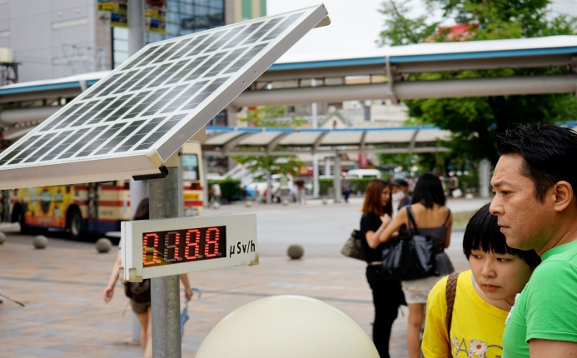
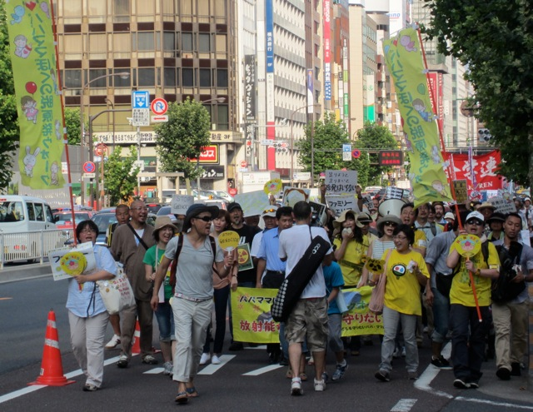
Evaluating the Influence of Antinuclear Protest Movements
in Public Assessments of Risk in post-3.11 Japan
Objectives:
Study of the perception of risk and responsibility around the use of nuclear power in contemporary Japan, as articulated by the emerging antinuclear protest movement, specifically the role of music and performance in generating social discourse around energy policy. This research address science and society interactions through a specific regional case study of collective social movements in the global crisis around safe and sustainable energy production
Methodology:
Ethnographic fieldwork conducted in Fukushima City and Tokyo, Japan in Summer 2013 at public protests and antinuclear festivals
Gathered online and print resources for qualitative analysis of public reactions to nuclear policy
Novak 2013a “Performing Antinuclear Movements in Post 3-11 Japan” STS Forum on Fukushima/Disaster Studies; Novak 2013b “The Sounds of Japan’s Antinuclear Movement” MoMA post website

