Slide 1
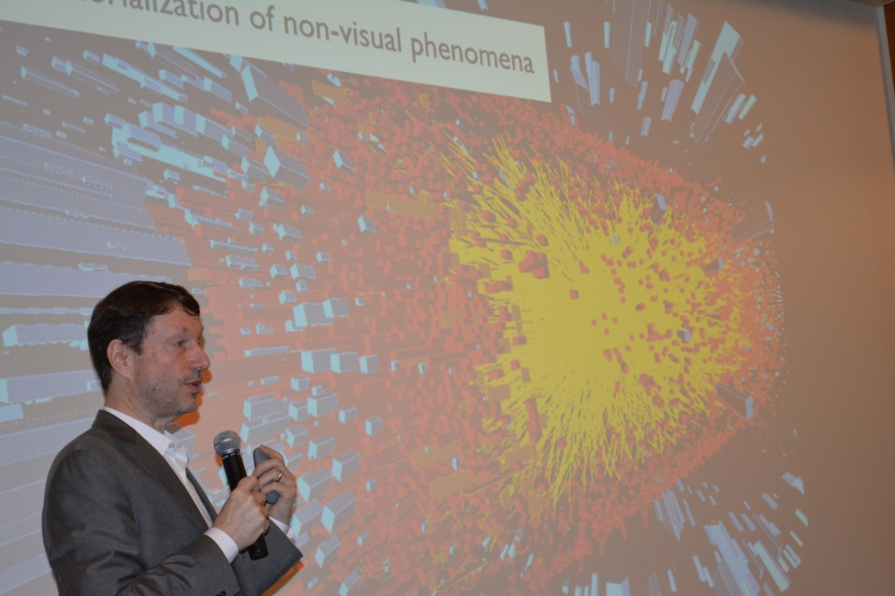
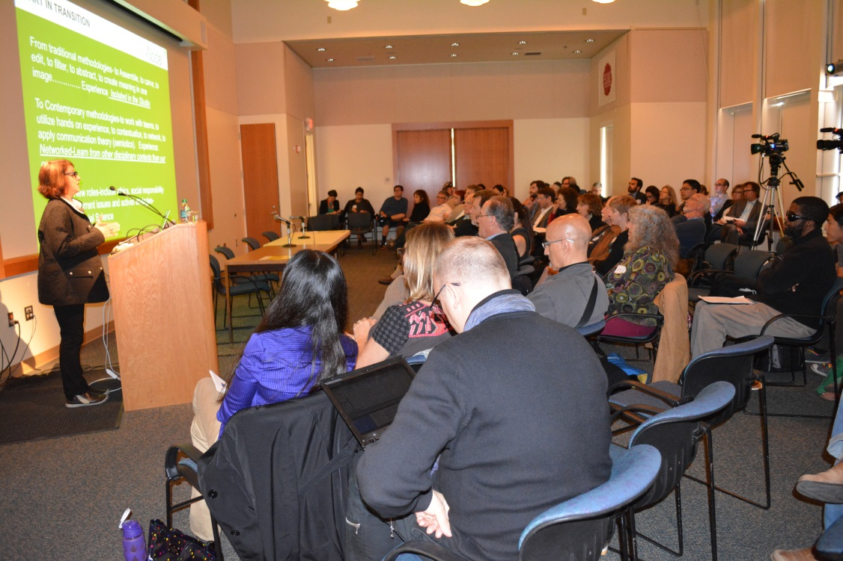
Day and a half symposium to initiate conversation among specialists from the sciences, social sciences, humanities and arts about how those communities intersect, with a focus on method
Future output will include 2016 exhibit at UCSB Museum of Art called “Vision and Wave
Partially funded through CNS-UCSB seed grant for conference organizer and Director of UCSB’s Experimental Visualization Lab
Videos of all talks available at: www.interrogatin-methodologies.org

