Slide 1
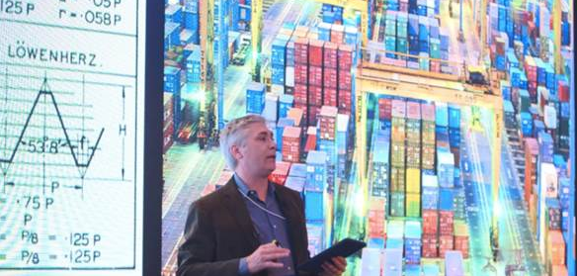
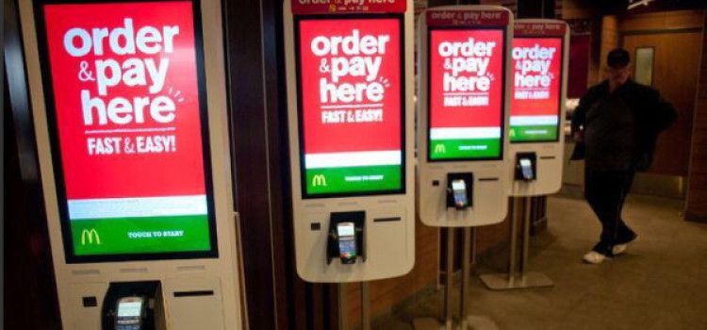
Magical Thinking Behind the 4th Industrial Revolution
Co-PI Patrick McCray delivered an address on the 4th Industrial Revolution -- the convergence of technologies among the biological, physical, and digital spheres – at the World Economic Forum
Technical standards allows users to create a consensus
Technology is built on top of each other and therefore, much of history gets hidden.
Innovation does not occur suddenly, it is based on what scientists do daily.
Innovation is almost always championed and very little emphasis is given to whether if it should happen.
Patrick McCray speaking at the World Economic Forum in Davos, Jan 2016
Innovation is not always beneficial:
It destroys jobs: automation displaced tens of thousands of workers from the 1920s-1950s
Technology occurs at the cost of heavy environmental impacts: ~30 nuclear power plants are needed to keep up with the world’s uploading and tweeting.
There is a lack of prominent tech individuals who deeply question technology.
What is needed: a more rigorous academic discourse on the history and social implications of technological advancements.
McCray, Patrick. 2016. A Brief History of Industrial Revolutions. World Economic Forum. Davos, Switzerland. Available at: https://www.youtube.com/watch?v=jI06RtB-_q4&feature=youtu.beA.
McCray, Patrick. 2014. The Technologists’ Siren Song. The Chronicle of Higher Education, March 10. Available at: http://chronicle.com/article/The-Technologists-Siren-Song/145107/.

