Slide 1
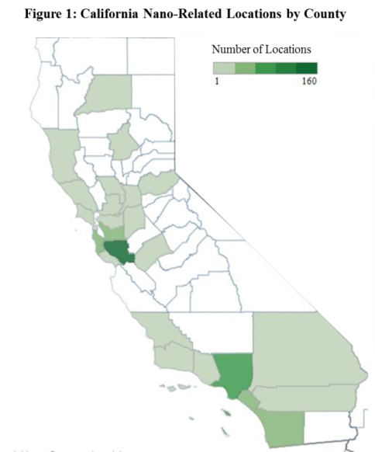
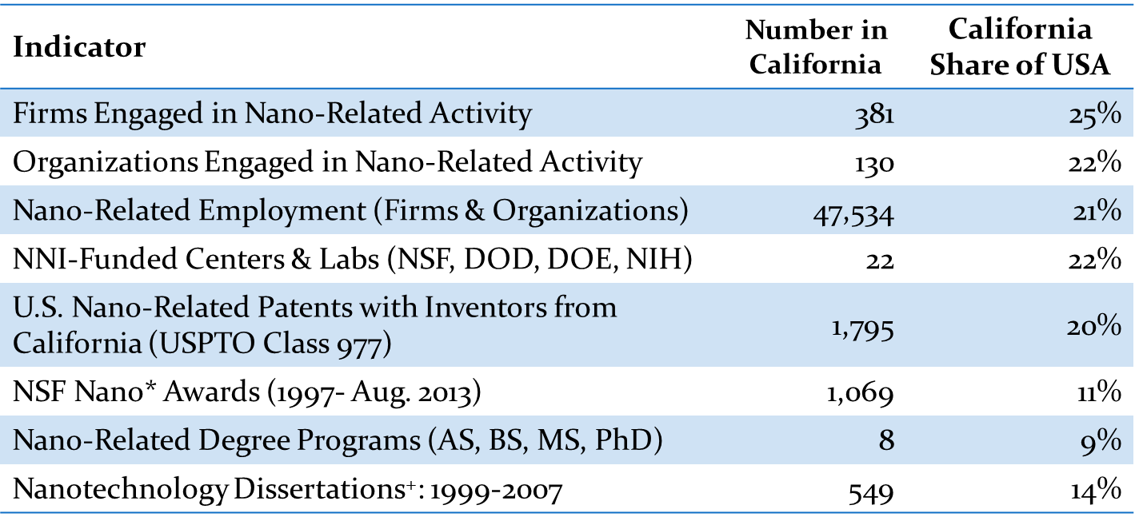
Profile of California’s Nano Economy: www.CaliforniaNanoEconomy. org
Introduction
Objective: Develop methods
and estimates of the California’s nanotechnology economy
Why: common goal among
stakeholders is to track and
measure economic, social and/or environmental impacts related to nanotechnology. This includes both positive (return on investment, job creation, revenue generation, energy efficiency) and negative (exposure & risk) impacts.
Needed: Data on key variables: firms, workers, products & geography
Sample Results
California accounts for the largest share (nearly one-quarter) of firms and supporting organizations engaged in nanotech-related activities in the United States (Fig 1).
There are 21 educational institutions (universities, community colleges and training centers) in California involved in nano- related activity via research groups; research centers and labs; degree programs; or other educational opportunities. California is also home to a significant share (22%) of the nano-specific research centers and labs funded by various government agencies through the NNI (Fig 1).
Largest concentrations of firms and organizations (Fig 2): Santa Clara county (31%) followed by Los Angeles (15%) and Alameda (12%) counties.
Fig. 2: Locations of California Nano-Related Firms
For more information see: Frederick, Stacey. (2013). California in the Nano Economy at www.CaliforniaNanoEconomy.org
Fig. 1: Snapshot of California Nano Activity

