Slide 1
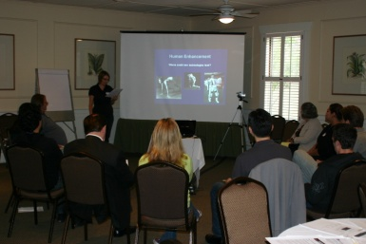
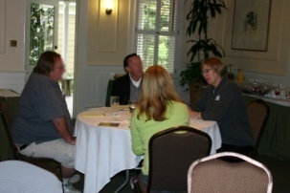
Deliberating Nanotechnologies in the US:
Gendered Beliefs and Patterns of Speech in Public Deliberation
SES 0824042
SES 0531184
Gender, Risk, and Equitable Participation:
Analysis of Speech and Discourse¹
Six deliberative workshops conducted Fall 2009 in Santa
Barbara,CA. Focused on
nanotechnology in
1) Energy/Environment
2) Health/Human enhancement
Results:
Men spoke 28% more than women (p =.02)
Men used more intrusive interruptions than women (p=.07), and white participants used more intrusive interruptions than others (p=.01)
Women used more backchannels than men, particularly in health contexts (p=.01)
Individuals who move towards a benefit stance on nano use more backchannels than those who do not change (p=.04)
Views on health and food nano applications
Health applications²
High levels of hope and hesitation for nano in health.
Ambivalence not necessarily a transitory state; complex risk/benefit views
Ambivalent statements voiced
more by people of color and
women
Food applications³
Nano for food/food packaging raised most discussion less certainty of benefits, consistent with many nano survey findings
All-women deliberation particularly skeptical of nano for food
Food a particularly sacred cultural domain, makes people uneasy about technological modifications
¹Harthorn, B.H., Rogers, J.B., Shearer, C., Denes, A., Cranfill, R., Hanna, S., Martin, T., Hurt, I.
²Barbara Herr Harthorn, Christine Shearer, and Jennifer Rogers-Brown. 2012. “Exploring Ambivalence: Techno-Enthusiasm and Skepticism in US Nanotech Deliberations,” Quantum Engagements (IOS Press).
³Jennifer Rogers-Brown, Christine Shearer, and Barbara Herr Harthorn. 2012. “From Biotech to Nanotech: Public Debates about Technological Modification of Food.” Environment and Society: Advances in Research, Volume 2.

