Slide 1
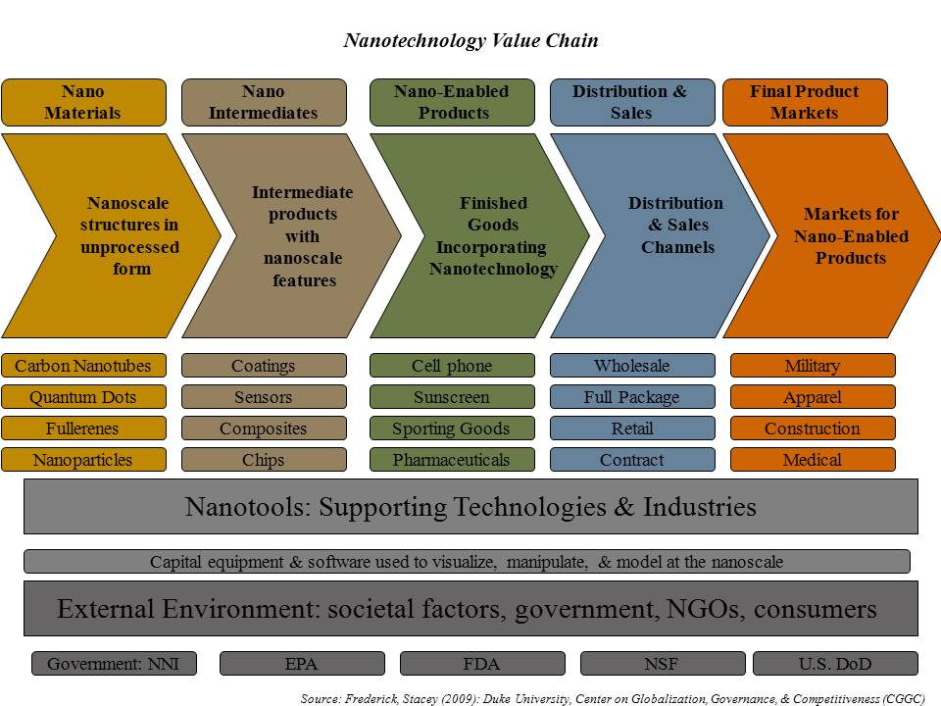
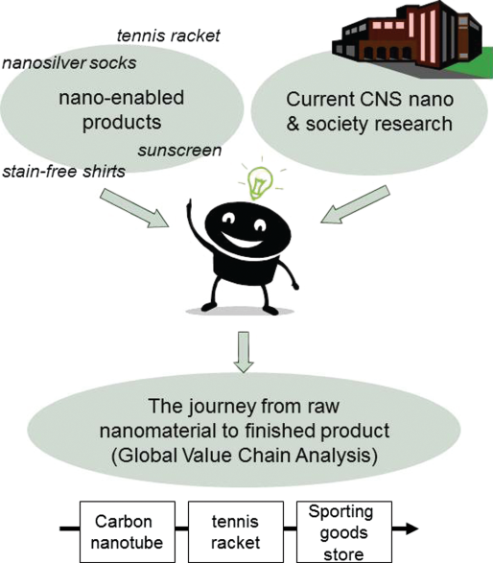
Traveling Technologies: An Innovative Global Value Chain Approach
to Teaching Nanotechnology’s Societal Implications
Overview
Traveling Technologies is a curriculum developed for an 8-week college summer internship program but useful in other educational contexts
Students work in teams to critically analyze the societal impacts of a nanomaterial by tracing the journey from origins and raw state to finished product or application
Teaches roles of firms, countries and products involved in bringing a product from concept to commercialization
Provides tangible outcome in the form of a diagram useful for educating and communicating issues to stakeholder audiences
Structure and approach easily adaptable to student level and numbers
Figure 1: Traveling Technologies Project Overview
Table I. Possible Research Questions Addressing Societal Impacts of Carbon Nanotubes (CNTs)
Areas of Societal Impact | Research Questions
Intellectual property & technology transfer | Are there patterns in the distribution (univ., industry, govt.) of CNT intellectual property (IP) in the US? How is IP related to innovation?
Risk & risk perception | What are the risks & regulatory frameworks for CNTs in medical applications, and what are the broader implications of these?
Media framing & the public sphere | What are the dominant frames in nano news stories, and what is the potential impact of public perception on CNT
Globalization, nano in China | Which companies & countries dominate the CNS industry, and what are the implications for the global economy?
Figure 2: General nanotechnology value chain
Project Components
Nanomaterial case study
Research question addressing a societal, ethical, or legal impact.
The Global Value Chain Framework for investigation and analysis.
Final presentation of results
Dillemuth, J., Frederick, S., Parker, R., Gereffi, G., & Appelbaum, R. (2011). Traveling Technologies: Societal Implications of Nanotechnology Through the Global Value Chain. journal of nano education, 3, 36-44

