Slide 1
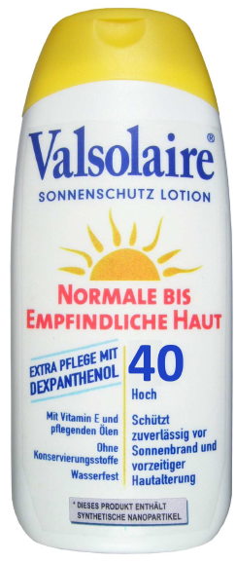
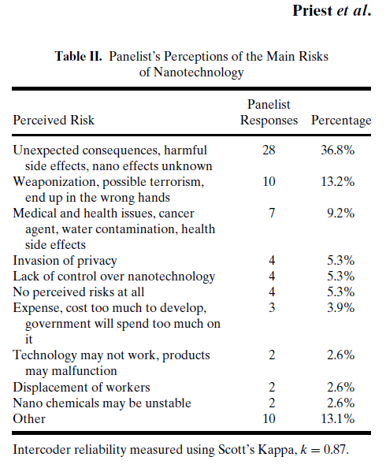
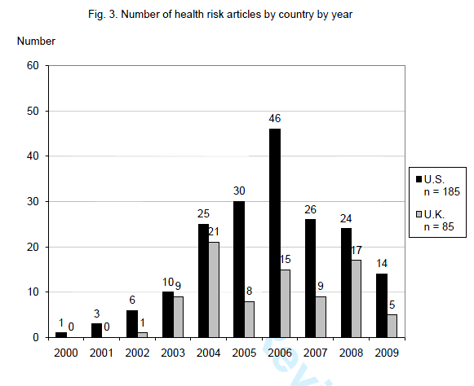
SES 0531184
Nanotechnology Risk Perceptions and Communication: Emerging Technologies, Emerging Challenges
CNS Santa-Barbara International Workshop, January 2010
International Contributions: US, UK, Canada, Switzerland, Germany
Topics: Newspaper Coverage, Emerging Perceptions, Vulnerability Justice and Fairness, Labelling Impacts, Risk Communication, Methodologies for Researching ‘Upstream’ Perceptions
Siegrist and Keller
Experimental stimulus used: lotion shown with ‘Nanoparticle’ label
Friedman et al.
Edited by Pidgeon, N., Harthorn, B., and Satterfield, T. 2011. “Nantoechnology Risk Perceptions and Communication: Emerging Technologies, Emerging Challenges. Risk Analysis (special issue). 31: 1694-1784.

