Slide 1
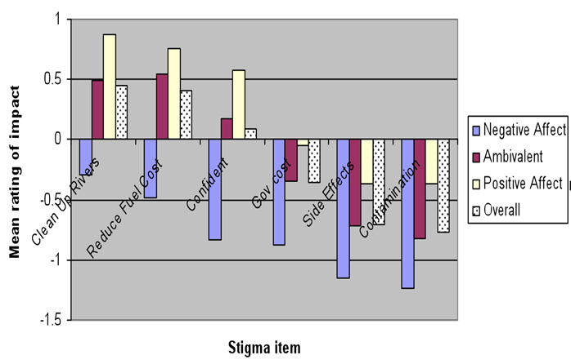
Affective neutrality in response to nanotechnologies
SES 0531184
Aims :
Negative affect predicts high perceived risk, but as most are affectively neutral in response to ENMs:
How does this ‘neutral’ group view nanotechnologies in response to + and – news stories as compared to negative v positive affect groups?
How do those now affectively neutral compare across known predictors of risk perception?
t-values are shown in parentheses *p<0.05,**P<0.01, ***p<0.001
Standardized regression coefficients from a series of three linear regression analyses (affectively negative, positive and ambivalent participants).
Methods
U.S. National survey (N=1,100)
Main Findings :
High levels of uncertainty or ambivalence about nanotechnologies.
Those reporting negative affect would stigmatize nanotechnologies even in positive scenarios (e.g. river cleanup improving salmon health).
Regression analyses show greater effect of risk predictors for affectively ambivalent respondents.
Satterfield, Corner, Pidgeon, Pitts and Harthorn (in prep) Affective Neutrality in Response to Nanotechnologies

